Slide 1
HNDIT1012 Visual Application Programming
Week 7

Slide 2
C# Strings
Strings are used for storing text.
A string variable contains a collection of characters surrounded by double quotes:
Example
Create a variable of type string and assign it a value:
string greeting = "Hello";

Slide 3
String Length
A string in C# is actually an object, which contain properties and methods that can perform certain operations on strings. For example, the length of a string can be found with the Length property:
string txt = "ABCDEFGHIJKLMNOPQRSTUVWXYZ";
int x=txt.Length;

Slide 4
String Methods
There are many string methods available, for example ToUpper() and ToLower(), which returns a copy of the string converted to uppercase or lowercase:
string txt = "Hello World";
string u=txt.ToUpper();
string v=txt.ToLower();

Slide 5
use the string.Concat() method to concatenate two strings:
string.Concat() method to concatenate two strings:
string firstName = "John ";
string lastName = "Doe";
string name = string.Concat(firstName, lastName);

Slide 6
Access Strings
You can access the characters in a string by referring to its index number inside square brackets [].
This example prints the first character in myString:
string myString = "Hello";
Console.WriteLine(myString[1]);

Slide 7
String methods
Methods Description
Format() returns a formatted string
Split() splits the string into substring
Substring() returns substring of a string
Compare() compares string objects
Replace() replaces the specified old character with the specified new character
Contains() checks whether the string contains a substring
Join() joins the given strings using the specified separator
Trim() removes any leading and trailing whitespaces
EndsWith() checks if the string ends with the given string
IndexOf() returns the position of the specified character in the string
Remove() removes characters from a string
ToUpper() converts the string to uppercase
ToLower() converts the string to lowercase
PadLeft() returns string padded with spaces or with a specified Unicode character on the left
PadRight() returns string padded with spaces or with a specified Unicode character on the right
StartsWith() checks if the string begins with the given string
ToCharArray() converts the string to a char array
LastIndexOf() returns index of the last occurrence of a specified string

Slide 8
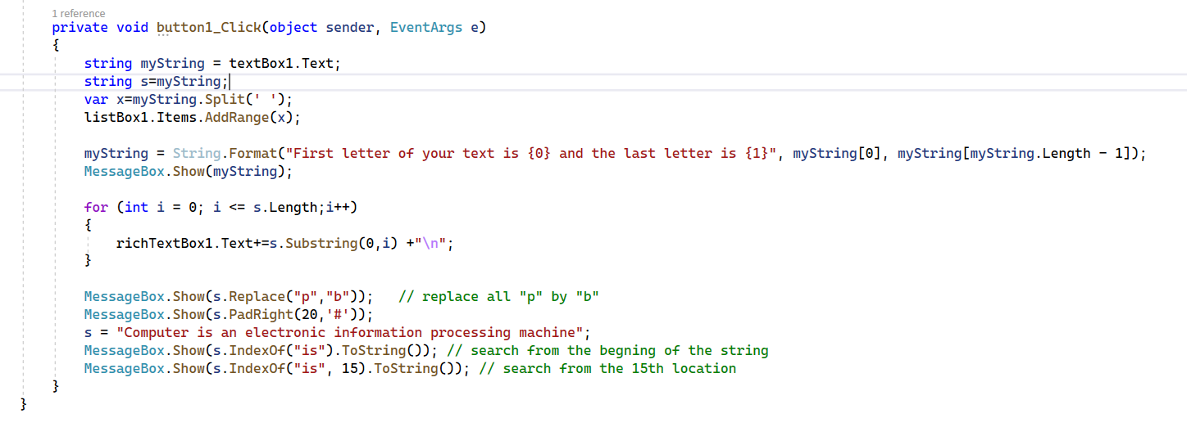

Slide 9
Thank You

